Slide 1
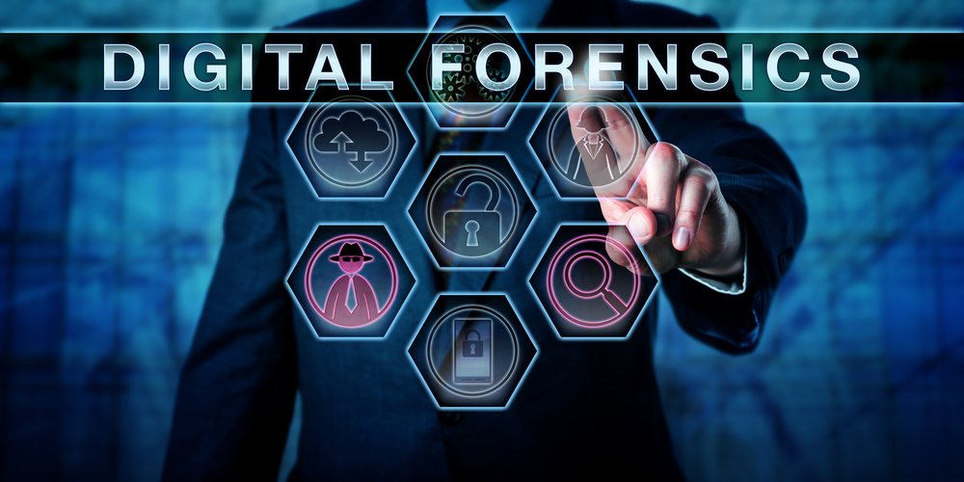
Digital Forensics
Instructor: Malik Saif Islam (Digital Forensics Expert,CEH,CHFI Certified)

Slide 2
Outline
Forensic and Digital Forensic Definitions
Digital Evidence
Digital Forensic Model
Digital Forensic Process
Need and Benefits of Digital Forensic
Applications of Digital Forensic
Skills required and Challenges faced by Digital Forensic
Digital Forensic Software Tools
Conclusion

Slide 3
What is forensic?
Collection and analysis of evidence
Using scientific test or techniques
To establish facts against crime
For presenting in a legal proceeding
Therefore forensic science is a scientific method of gathering and examining information about the past which is then used in court of law

Slide 4
What is digital forensic?
Digital Forensics is the use of scientifically derived and proven methods toward:
the preservation, collection, validation, identification, analysis, interpretation, documentation, and presentation of digital evidence derived from digital devices
for the purpose of facilitation or furthering the reconstruction of events found to be criminal, or helping to anticipate unauthorized actions shown to be disruptive to planned operations.

Slide 5
Branches of Digital Forensics
The technical aspect of an investigation is divided into several sub-branches, relating to the type of digital devices involved:
Computer forensics, Web Forensics, Email Forensics, Network forensics, Malware Forensics and Dark Web forensics.
The typical forensic process encompasses the seizure, forensic imaging and analysis of digital media and the production of a report into collected evidence.

Slide 6

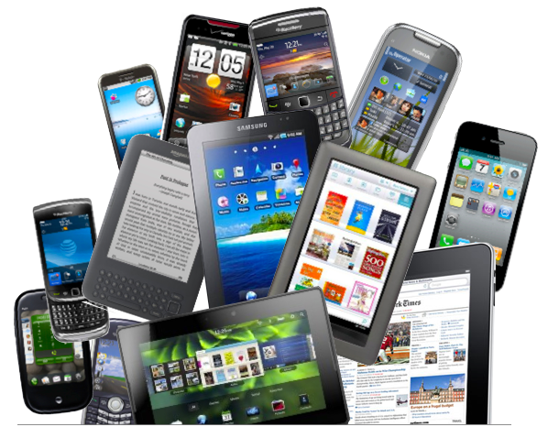
Examples of Digital Forensic Devices

Slide 7
Digital Evidence
Evidence
A piece of information that supports a conclusion
Digital evidence
Any data that is recorded or preserved on any medium in or by a computer system or other similar digital device, that can be read or understood by a person or a computer system or other similar device.
It includes a display, printout or other output of that data.

Slide 8
Characteristics of Digital Evidence
An evidence must be:
Admissible
Conformity with the common law and legislative rules
Authentic
In linking data to specific individuals and events
Fragile
Easily altered, damaged, or destroyed
Accurate
Believed and is consistent
Complete
With a full story of particular circumstances.
Convincing to juries
To have probative value, subjective and practical test of presentation – To proving beyond doubt

Slide 9
Examples of Digital Evidence
Many court have allowed the use of:-
e-mails,
digital photographs,
ATM transaction logs,
word processing documents,
Instant message histories,
files saved from accounting program,
spreadsheets,
internet browser histories,
databases,
the contents of computer memory,
computer backups, computer printouts,
Global Positioning System tracks,
logs from a hotel’s electronic door locks, and
digital video or audio files

Slide 10
Types of Digital Evidence
Persistant data
Meaning data that remains intact when the digital device is turned off. E.g. hard drives, disk drives and removable storage devices (such as USB drives or flash drives).
Volatile data
Which is data that would be lost if the digital device is turned off. E.g. deleted files, computer history, the computers registry, temporary files and web browsing history.

Slide 11
Location for Evidence
Internet History Files
Temporary Internet Files
Slack/Unallocated Space
Buddy lists, personal chat room records, P2P, others saved areas
News groups/club lists/posting
Settings, folder structure, file names
File Storage Dates
Software/Hardware added
File Sharing ability

Slide 12
Digital Forensic Model
Because digital forensics is a new discipline:
there is little standardization and consistency
across the courts and industry

Slide 13
Different Digital Forensic Models Published
No. | Digital Forensic Model or framework | No of phases
1 | Computer forensic process (M.Politt, 1995) | 4 processes
2 | Generic Investgative Process (Palmer, 2001) | 7 Clases
3 | Abstract model of Digital forensic procedure (Reith, Carr, & Gumsch, 2002) | 9 Proceses
4 | An integrated digital investigation proceses (Carrier & Spafford, 2003) | 17 Process
5 | End to End Digital Investigation (Stephenson, 2003) | 9 Steps
6 | Enhenced Integrated Disgital Investigation Process (Baryamureeba & Tushabe, 2004) | 21 Phases

Slide 14
Different Digital Forensic Models Published…
7 | Entended Model of CiberCrime investigation Ciardhuain, (2004) | 13 Activities
8 | Hierachical, Objective – bases Framework (Beebe & Clark, 2004) | 6 Phases
9 | Event based Digital Forensic Investigation framework (Carier and Spafford, 2004) | 16 Phases
10 | Forensic Process (Kent K, Chevalier, Grance & Dang, 2006) | 4 Proceses
11 | Investigation framework (Kohn, Eloff, & Oriva 2006) | 3 Stages
12 | Computer forensic field Triage Process Model (K.Rogers, Goldman, Mislan, Wdge, & Debrota, 2006) | 4 phases
13 | Investigative Process Model ( Freiling & Schawittay, 2007) | 4 phases

Slide 15
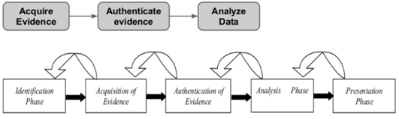
Digital Forensic Basic Model

Slide 16
Digital Forensic Process
Broad process steps:
Identification
Preservation
Analysis
Documentation
Presentation

Slide 17
Identification
The first step in the forensic process:
What evidence is present
Where it is stored and
How it is stored
Electronic stores can be:
Person computers
Mobile phones
PDAs
Smart cards
Key parameters in identification:
Type of information
format

Slide 18
Preservation
Isolate, secure and preserve the state of physical and digital evidence.
This includes preventing people from using the digital device or allowing other electromagnetic devices to be used within an affected radius.

Slide 19
Analysis
Determine significance, reconstruct fragments of data and draw conclusions based on evidence found.
It may take several iterations of examination and analysis to support a crime theory.

Slide 20
Documentation
A record of all visible data must be created, which helps in recreating the scene and reviewing it any time
Involves proper documentation of the crime scene along with photographing, sketching and crime-scene mapping.

Slide 21
Presentation
Summarize and provide explanation of conclusions.
This should be written in a layperson’s terms using abstracted terminologies.
All abstracted terminologies should reference the specific details.

Slide 22
Need for Digital Forensics
To ensure the integrity of digital system.
To focus on the response to hi-tech offenses, started to intervene the system.
Digital forensics has been efficiently used to track down the terrorists from the various parts of the world.
To produce evidence in the court that can lead to the punishment of the criminal.

Slide 23
The Benefits of Digital Forensics
Digital Forensics help to protect from and solve cases involving:
Theft of intellectual property
This pertains to any act that allows access to patents, trade secrets, customer data, and any confidential information.
Financial Fraud
This pertains to anything that uses fraudulent solicitation of victims information to conduct fraudulent transactions.

Slide 24
The benefits of digital forensics ...
Hacker system penetration
Taking advantage of vulnerabilities of systems or software using tools such as rootkits and sniffers.
Distribution and execution of viruses and worms
These are the most common forms of cyber crime and often cost the most damage.

Slide 25
Applications of Digital Forensics
Financial Fraud Detection
Criminal Prosecution
Child pornography (Michael Jackson case)
Civil Litigation (evidence in court cases and proceedings)
Perjury (false swearing) (Clinton - Lewinsky case)
Corporate Security Policy and Acceptable Use Violations
Embezzlement (Misuse, fraud, cheating etc.)
Email threats data theft-industrial espionage (spying, intelligence units)

Slide 26
Challenges faced by Digital Forensics
The increase of PC’s and internet access has made the exchange of information quick and inexpensive.
Easy availability of Hacking Tools.
Lack of physical evidence makes crimes harder to prosecute.
The large amount of storage space available to suspects
The rapid technological changes requires constant upgrade or changes to solutions

Slide 27
Skills required for Digital Forensics
Application of Programming or computer-related experience
Broad understanding of operating systems and applications
Strong analytical skills
Strong computer science fundamentals
Strong system administrative skills
Knowledge of the latest intruder tools
Knowledge of cryptography and steganography
Strong understanding of the rules of evidence and evidence handling
Ability to be an expert witness in a court of law

Slide 28
Conclusion
Digital forensics is important for solving crimes
with digital devices
against digitial devices
against people where evidence may reside in a device
Several sound tools and techniques exist to search and analyse digital data
Regardless of existing tools, evolving digital age and development of technology requires heavier research in digital forensics

Slide 29
References
www.accessdata.com.(2006).
http//www.logicubeforensics.com/.(2008).
http://www.dibsusa.com/.
http://www.computerforensicshq.com. (n.d.). Panagiotis, K. (2006).
Digital Crime and Forensic Science in Cyberspace. USA: Idea Group Publishing. Wiles Jack, C. K. (2007).
The Best Damn Cybercrime and Forensics Book Period. USA: Syngress Publishing.
www.zawya.com. (n.d.).

Slide 30
END OF THE PRESENTATION
Thank You

